Slide 1
Best Club Award
The Rebuilding of the RTP Rotary Club
Notes:
In October of 2014, our club was on the brink:
-while we had a president, we didn’t have a president elect
-we were in financial trouble
-no service projects
-membership low teens, w/ average 6-8 showing up at a meeting

Slide 2
LEADERSHIP
Notes:
You have to have someone to step up and make the change happen. And realistically, you have better success with a group. And at first, you might have to drag some of the others.
YOU NEED LEADERSHIP

Slide 3
THINK DIFFERENTLY
Notes:
We as rotary clubs keep doing the same thing over and over again. We meet in the same place, have the same meal, do the same projects, do the same fundraiser that should have been put to bed years ago. We revisited everything we had done and also looked at what we were not doing.
THINK DIFFERENTLY

Slide 4
REFRAME
Notes:
Anyone like to run into a burning building? No one wants to join a club, organization or business that is dying.

Slide 5
REFRAMED to “REBOOT”
Notes:
We reframed the situation. We started to look through a different lense. We were no longer a club that was about to be dead, but we were a club that was rebuilding.
REBOOT
-Lots like to be on the ground floor, or be part of a startup

Slide 6
THE WHY or THE COMPELLING VISION OF THE FUTURE
Notes:
Let people know why we need to change and how the benefits us
Help align everyones goals
Provide a road map of where we are going and how to get there

Slide 7
THE WHY or THE COMPELLING VISION OF THE FUTURE
Notes:
Grow to 25 members, then to 50.
A service project a month
Easy way to sell who we are, what we believe in

Slide 8
CONSTANT COURSE CORRETION
APOLLO 11 was off course 90% of the time, but still made it to the moon.
Notes:
While we had this vision of the future, we didn’t make it set in stone. We were open to feedback, criticism and new ideas. We keep making course corrections along the way. In the past 12 months, we have done two membership surveys.

Slide 9
GET GREAT SPEAKERS
Notes:
This is truly key. A speaker can make or break a meeting, for not only your club members but for guests.
We went from having the speakers rotate between members, to putting together a small team to organize great programs.

Slide 10
MEMBERSHIP PROCESS
Notes:
Invite guests to hear great speakers, hold lunch & learns, gather people’s email when they visit for following up, 5 touch points – follow up with strategic map & club brochure

Slide 11
MEMBERSHIP TIERS
Scholarship Spots
Junior Membership
Full Membership
Notes:
Scholarship Spots – gave one out to full fill a need – he acts as club journalist and does our newsletter
-gave out 6 spots to bright students
-helped offset by higher paying dues members
Junior $150 quarter – 32 & under

Slide 12
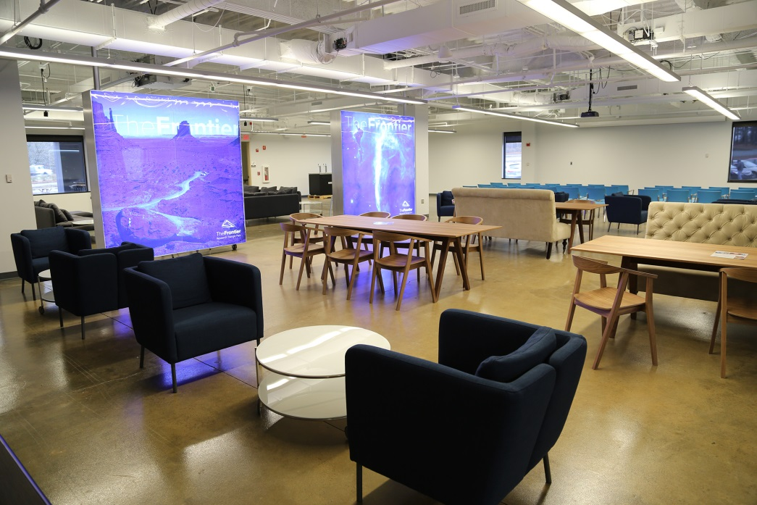
CHANGE THE MEETING
Notes:
A lot of us clubs, and us to, we meet in the same place and do things they say way. We meet in boring, dark rooms. Why tech companies have really cool offices.
We removed old traditions. We dropped the invocation.

Slide 13
BE SEEN

Slide 14
BE SEEN

Slide 15
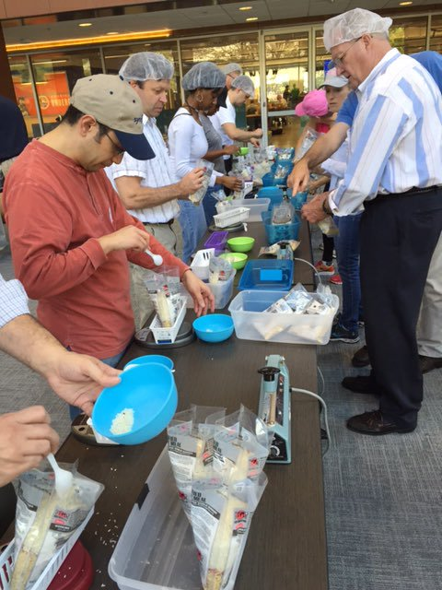
BE SEEN

Slide 16
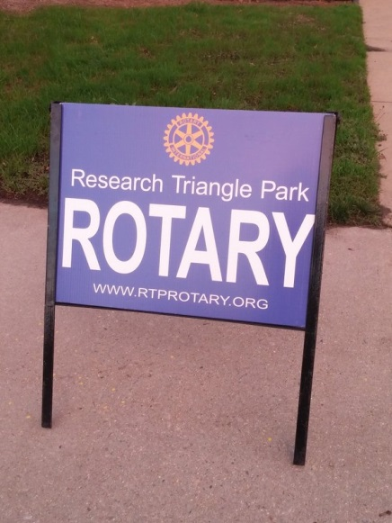
BE EASY TO FIND
Notes:
Make sure people can actually find you. We relaunched a website, started a weekly newsletter, created social media. We even went and used realtor open house style signs.

Slide 17
CHANGE IS HARD
Notes:
Change is Hard. Recognize with change, loss will come – good people will leave and that is ok.

Slide 18
RECEIPE FOR SUCESS
Leadership
Think Differently
Reframe
What is the Why
Course Corrections
Great Speakers
Membership Process
Tiered Membership
Change the Meeting
Be Seen
Be Easy to Find
Accept Change

Slide 19
President@RTPRotary.org

